Slide 1

Latest News and Developments
Craig Chiffers
@cchiffers

Slide 2


Slide 3




R.I.P
TLS 1.0
31/10/18

Slide 4
Date Extended: October 31st 2018 for Office 365
(Previously March 1st 2018)
Affects all connectivity to Office 365, including:
Outlook connectivity
Windows Vista, 7 and 2008R2
Lync Phone Edition handsets
For advice and how-to’s: http://goo.gl/1Nmemf
TLS
1.0
Notes:
(They don’t support anything higher than TLS 1.0 and are running on Windows Embedded CE 6.0 released in 2006!)

Slide 5


Slide 6
So many new features in Teams!
Microsoft Teams Roadmap:
https://products.office.com/en-US/business/office-365-roadmap
Notes:
Command bar and then demo of the whobot (0.2 beta)

Slide 7
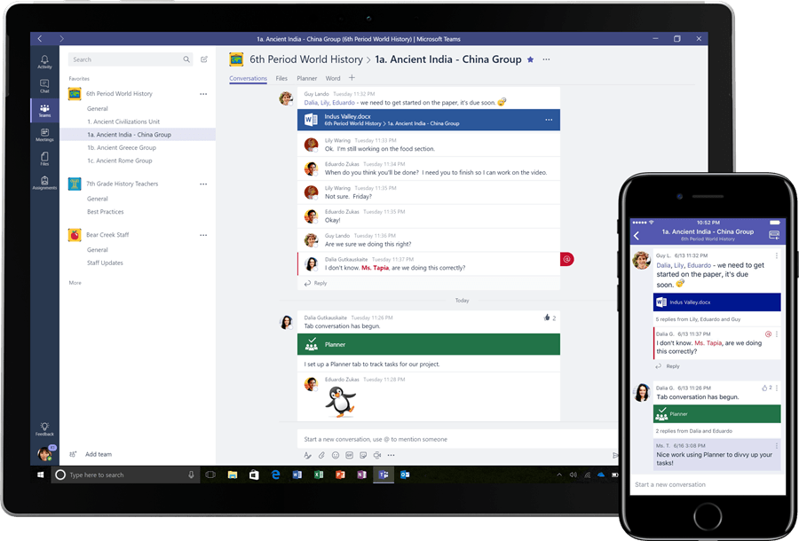
Screen sharing now available in Microsoft Teams Mobile App.
Available on iPad today.
Feature only available in Teams.
Notes:
Command bar and then demo of the whobot (0.2 beta)

Slide 8
Cloud Recording for meetings is in public preview.
Recordings are stored in the cloud in Microsoft Stream.
Requirements:
User has an Office 365 Enterprise E1, E3, or E5 license
User needs to be licensed for Microsoft Stream
User has Microsoft Stream upload video permissions
User has consented to the company guidelines, if set up by the admin
User has sufficient storage in Microsoft Stream for recordings to be saved
User has TeamsMeetingPolicy-AllowCloudRecording setting set to true
User has TeamsMeetingPolicy.AllowTranscription setting set to true, so user can choose whether to automatically transcribe the recordings
User is not an anonymous, Guest, or federated user in the meeting
Notes:
Command bar and then demo of the whobot (0.2 beta)

Slide 9
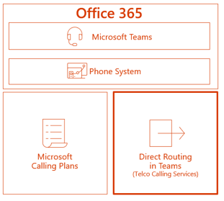

PSTN calling is available from Teams via Direct Routing and Telstra PSTN Calling.
Notes:
Command bar and then demo of the whobot (0.2 beta)

Slide 10
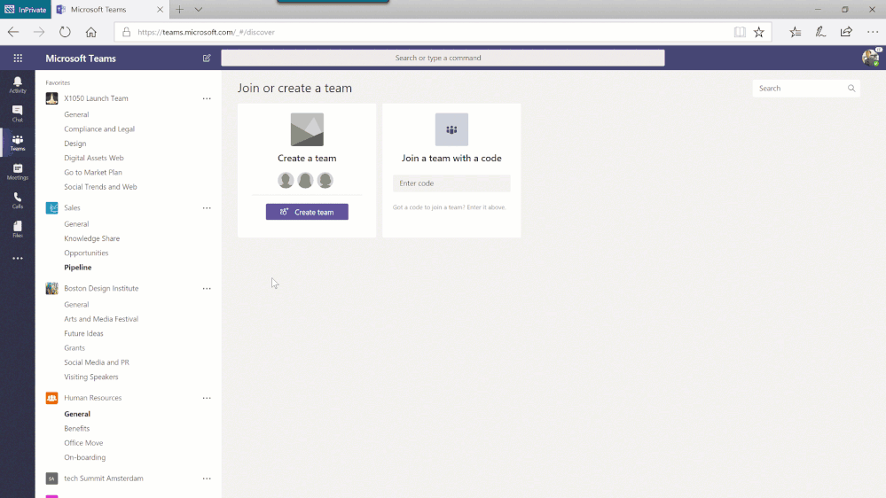
You can now create a new team and use an existing team as a template.
Notes:
Command bar and then demo of the whobot (0.2 beta)

Slide 11
Vendor news

Slide 12




Slide 13
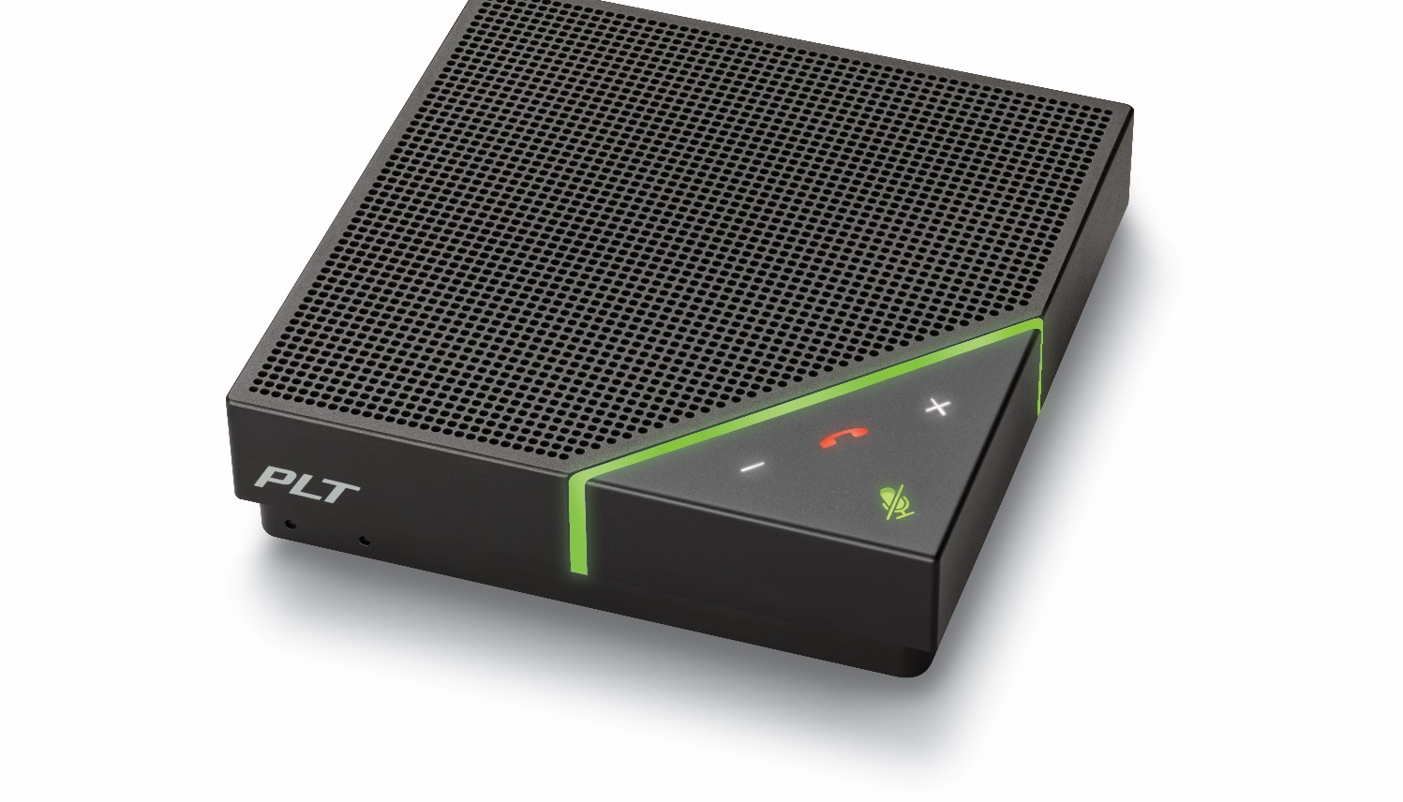
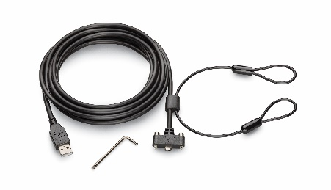
Introducing Calisto 7200
Four directional microphones
6.5-hour battery talk time
Pick up voices from anywhere in the room
Run all day without recharging
Bluetooth® clearing function
Bluetooth® connectivity
Remove previously paired devices
Dedicated button makes wireless-pairing simple
USB cable with locking mechanism
Call controls
Ensure speaker phone remains stationary
Answer/end calls, adjust volume, with one touch

Slide 14


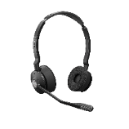
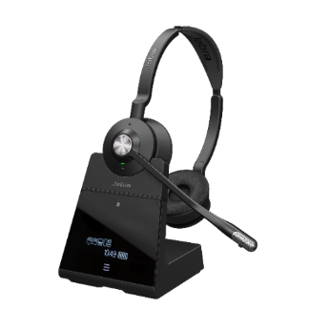
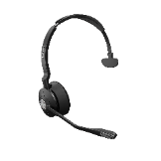
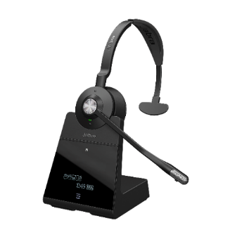
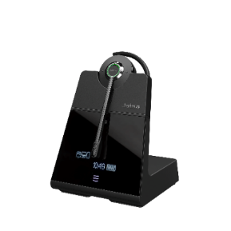
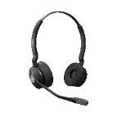
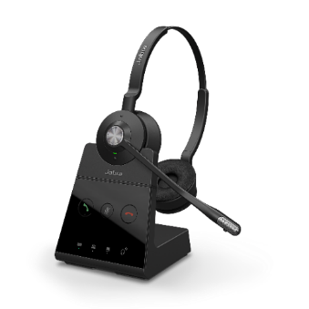
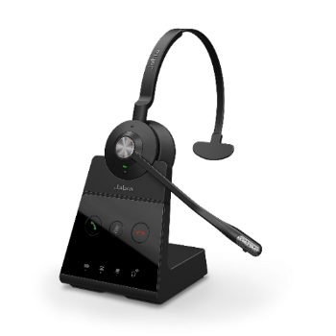

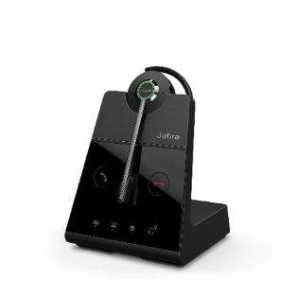

Jabra Engage Series
Microsoft Open Office & Outdoor Certification
Engineered to be the world’s most powerful professional wireless headsets*
v
Engage 75
Engage 75 Stereo
Engage 75 Mono
Engage
75 Convertible
Connect up to 5 devices (desk phone, softphone and 2 Bluetooth devices)
Engage 65
Engage 65 Stereo
Engage 65 Mono
Engage
65 Convertible
Connect 2 devices (desk phone and softphone)

Slide 15








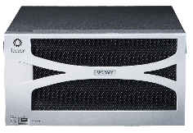


Ribbon Enterprise SBC Portfolio with Teams in 2018
192 Sessions
MSFT Cert
SBA
TDM and SIP
600 Sessions
MSFT Cert
SBA
TDM and SIP
Small Enterprise
Large Enterprise
150,000 Sessions
MSFT Cert
SIP (10GB)
High Availability
JITC (1H 2018)
75,000 Sessions
MSFT Cert
SIP (up to 10GB)
High Availability
JITC (2H 2018)
User-defined sessions
Virtual and Cloud
MSFT Cert
SIP
Microservices
JITC Cert
GPU, CPU and DSP Transcode
Virtual
NFV/Cloud
1,000 Sessions
Virtual
MSFT Cert
SIP
CPU Transcode

Slide 16
?

Slide 17

Thank you
@cchiffers

