Slide 1
Latest UC News and Developments
Craig Chiffers
@cchiffers

Slide 3
R.I.P TLS 1.0 31/10/18

Slide 4
Date Extended: October 31st 2018 for Office 365 (Previously March 1st 2018)
Affects all connectivity to Office 365, including:
Outlook connectivity
Windows Vista, 7 and 2008R2
Lync Phone Edition handsets
For advice and how-to’s: http://goo.gl/1Nmemf
TLS
1.0
Notes:
(They don’t support anything higher than TLS 1.0 and are running on Windows Embedded CE 6.0 released in 2006!)

Slide 5
Notes:
Windows Vista – need to upgrade.
Windows 8 and above – all good!

Slide 6
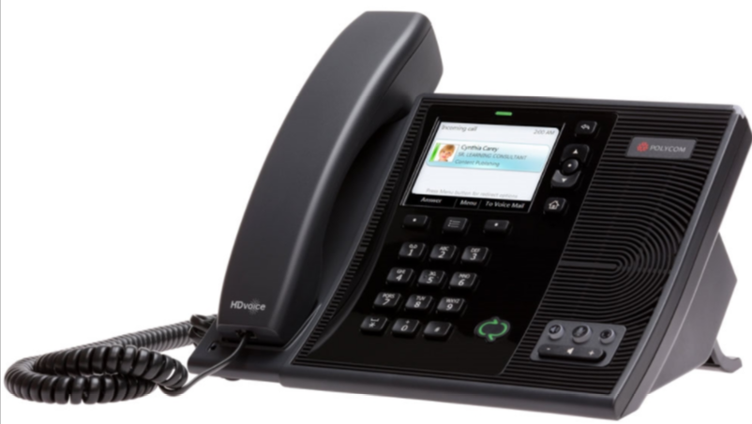
Notes:
Lync phone edition handsets cx600 – paperweight! – replace with Skype for business supported handsets.

Slide 7
Skype for Business Qualified Devices:
https://goo.gl/crmAoZ
Notes:
Lync phone edition handsets cx600 – paperweight! – replace with Skype for business supported handsets.

Slide 9
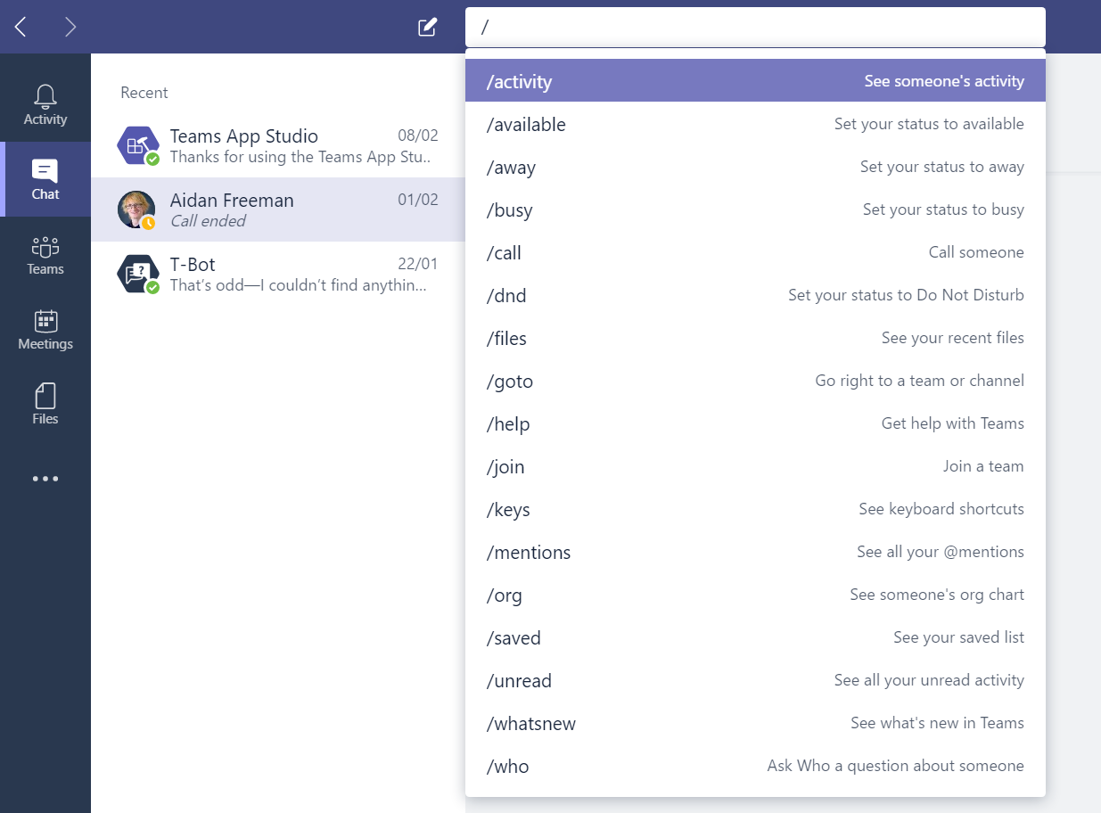
New Teams Features:
The Command Bar
WHOBot
Notes:
Command bar and then demo of the whobot (0.2 beta)

Slide 11
There will be a vNext edition of Skype for Business Server
Skype for Business Server 2019
Microsoft originally stated Enterprise Edition only
Have now confirmed Standard Edition will be released
Focus on Hybrid with Office 365
Requires Server 2016 and SQL 2016
Release date: Some time in 2018.
Lots of unconfirmed rumours!

Slide 13
Cloud is Key

Slide 14
Office 365 news

Slide 15
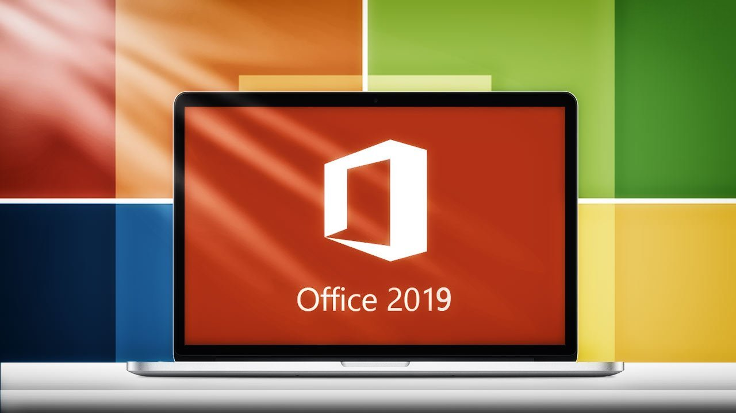

Slide 16
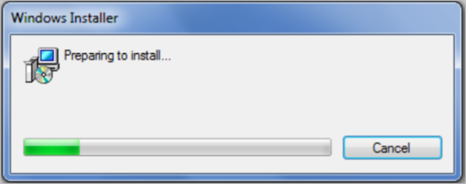
No MSI for
Office 2019
Notes:
No more MSI for Office 2019

Slide 17
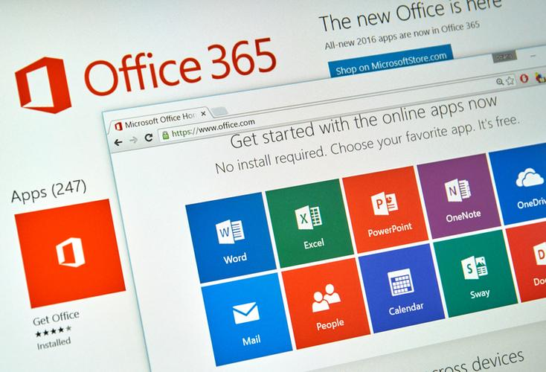
Office 2019 will only come as a click to run installer
Office 2019 will be released sometime in 2018 (unconfirmed)
Will only work with Windows 10 (unconfirmed)
Notes:
No more MSI for Office 2019

Slide 18
Vendor news

Slide 19
Version 6.1.5 SBC edge released
Lots of good fixes including:
911 call pre-emption (will drop another call if the SG is full and someone dials 911)
Ethernet redundancy
SWe Lite Capacity Expansion: 4G RAM, 4 vCPU, up to 1000 calls! (300 G.711 to G.729 transcoded sessions)
Notes:
No more MSI for Office 2019

Slide 20
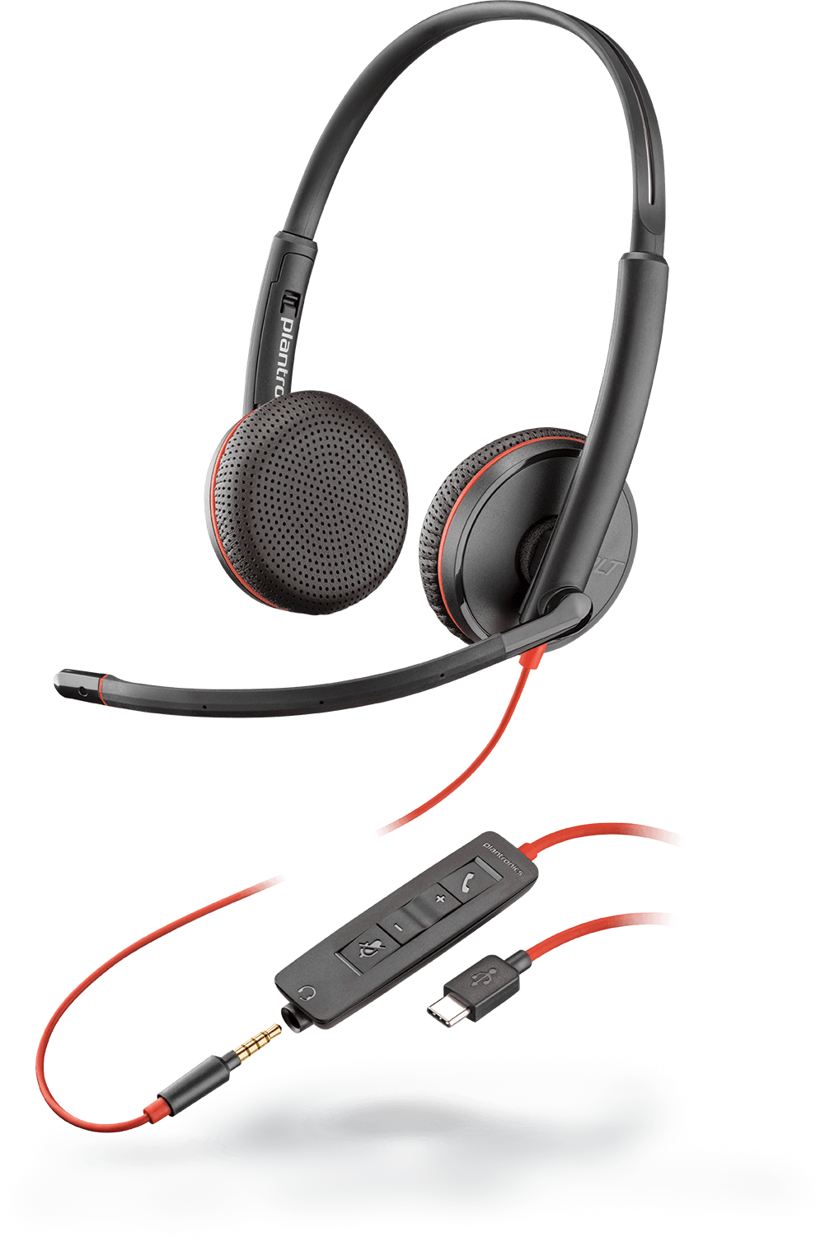
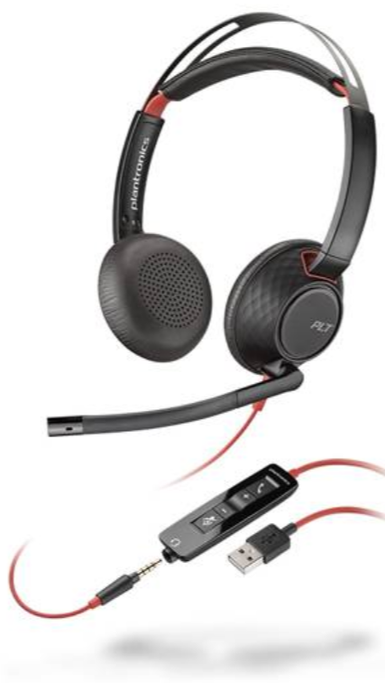
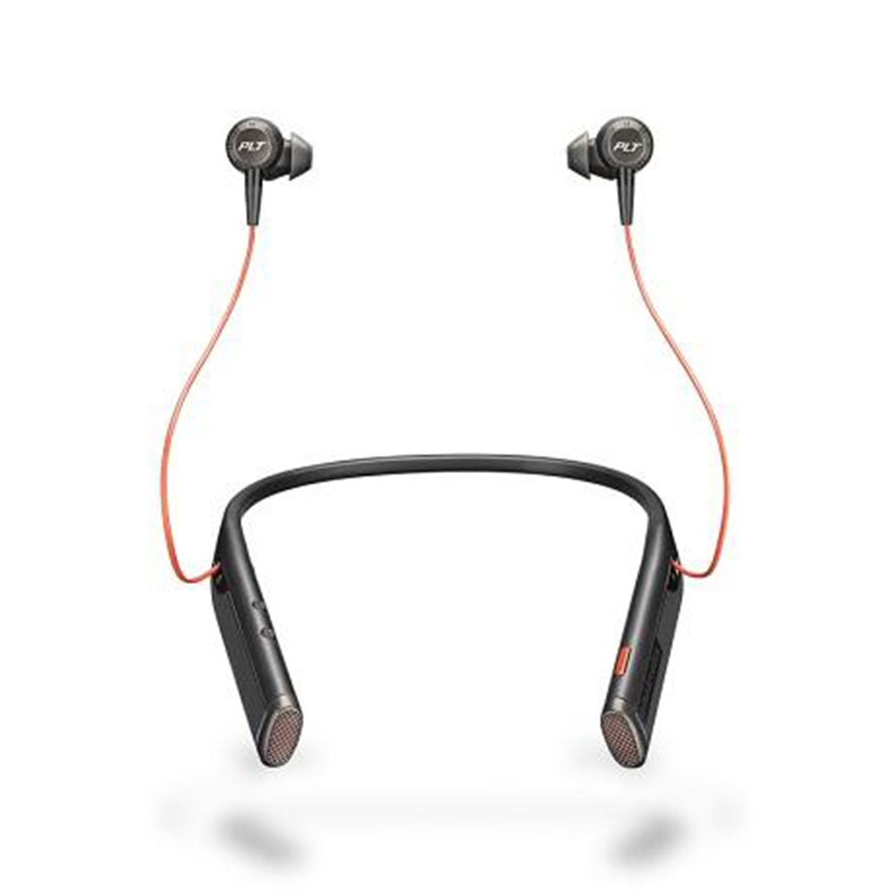
Updates to Blackwire 3200 and 5200 Series - now USB-C Compatible
Improved Design with better comfort and audio quality
NEW: Voyager 6200 UC
Professional business grade audio in versatile Bluetooth neckband headset with earbuds (includes Active Noise Cancelling)

Slide 21
Jabra Evolve Range
v

Slide 22
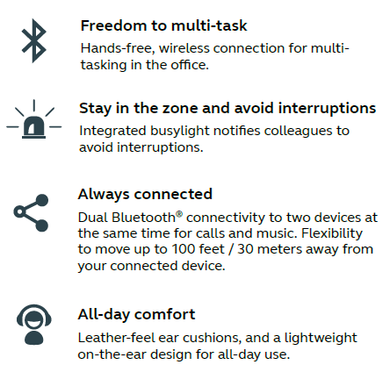
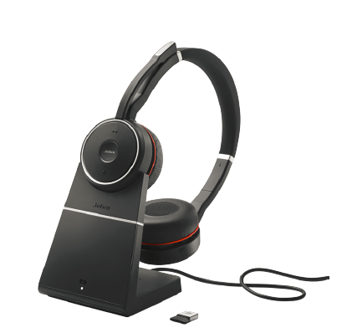
Jabra Evolve 75
v

Slide 23
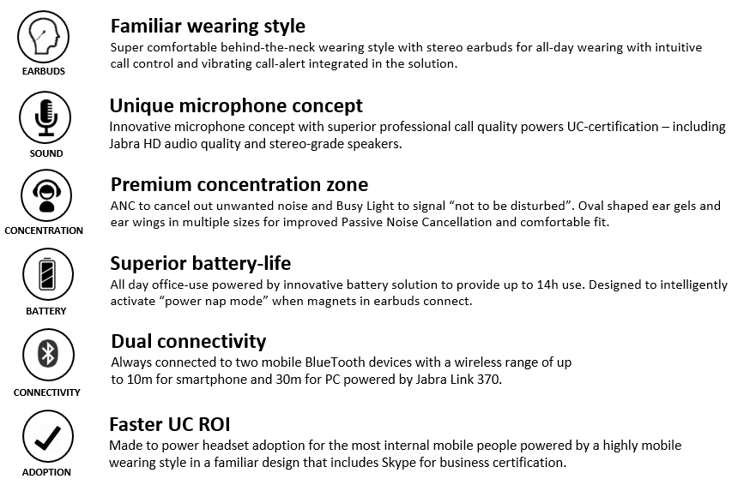
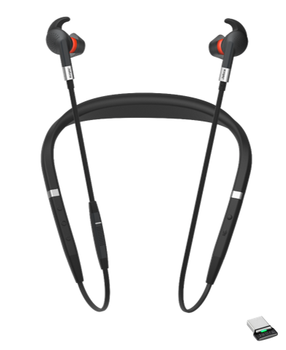
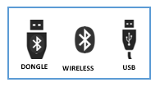
Jabra Evolve 75e
v
Notes:
Firmware updates using software

Slide 24
Questions?

Slide 26
Thank you

