Slide 1
Latest UC News and Developments
Craig Chiffers
@cchiffers

Slide 3
SWe Lite Features
Capacity Increase: 1000 sessions, 5000 registrations
50 transcode/encrypted sessions in 1 vCPU, 1 GB RAM
IPv6, IPv4↔IPv6 interworking
VLAN support
Multiple media streams, incl. video
General SBC Edge Features
SIP trunking-related SIP server failover
911 Call Pre-emption
Ethernet Redundancy (SBC 1000/2000 only)
SNMPv3
SFB / CCE Enhanced Security &Ease Of Use
Manual CCE Update
Improved CCE provisioning for update window, hybrid sites, TLS
Proxy Server settings now in GUI
Version 7.0 December 17

Slide 4
Office Online Server (Office Web Apps) November 2017 Update Released
Performance improvements
Emoji support in Word Online
Doubled time limit for audio recordings in OneNote Online
Lots of bug fixes
Notes:
Customers can download the update via the volume licensing portal
Requires previous version is removed first prior to install.

Slide 5
Cloud Connector Edition 2.1 Announced
Coexistence with SfB Server is dead
No CCE and SfB Server co-existence – ever
Alternatives: Split Domain Hybrid PSTN via SfB Server or Third Party Appliance
Focus on managing CCE via Operations Management Suite:
Key services to insure the solution is green and available
Hardware utilization for the virtual machines
Key statistics such in-bound and out bound calls to allow for fine tuning of resources

Slide 6
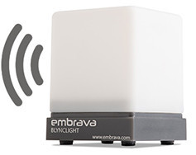
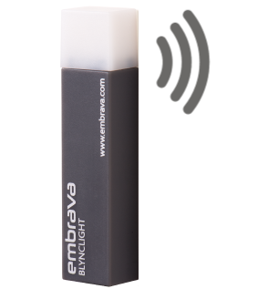
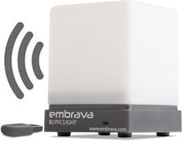
Embrava Partner Program
Partner Portal
Lead Generation & Nurturing Programs
Deal Registration
Register your interest as a reseller: https://embrava.com/pages/contact
Blynclight Standard
Blynclight Plus
Blynclight Mini
Blynclight Wireless
Visual alerts
Visual alerts
Audio alerts
Visual/Audio alerts
Designed for laptops
Visual/Audio alerts
RF 2.4GHz

Slide 7
Plantronics and Microsoft working together on Cloud Voice adoption Plantronics joined Microsoft in easing some of the pain points along this journey with the announcement of the addition of Plantronics to Microsoft’s MyAdvisor site (formerly known as Skype Operations Framework or SOF).
Plantronics Joint Development with Nectar for Ear-to-Ear (e2e) Diagnostics
Nectar Services Corp. announced a joint development and strategic alliance agreement with Plantronics to build the industry’s first ear-to-ear (e2e) diagnostics solution. The goal of this partnership is to provide enterprises and their service providers with the ability to quickly troubleshoot call quality issues that may originate anywhere – from within the network all the way out to a user’s wireless headset. With this new capability, service providers and enterprises can resolve issues faster, ensure superior call quality across the network and improve customer service.

Slide 8
Questions?

Slide 9
Thank you

